Slide 1
IBM Rational ClearQuest
By: Israel lazar
Notes:
This module covers ClearCase and ClearQuest

Slide 2

ClearQuest Overview
Rational CQ tracks defects through the software development and testing processes.
Support various databases including Access DB2 Oracle Sql .
Full web support.
Integrates with ClearCase.
Support users and groups administration.
Enable Email notification.
Easy to customize.

Slide 3

Simplify and control change
What if you could…
  Easily capture all
  stakeholder requests?
  Communicate real-time project status to your managers
  and teams?
  Control and manage change as a single activity across the spectrum of software assets while supporting 21 CFR part 11 standards for electronic signatures and record keeping?
  Get started with out-of-the-box forms and workflows that you can easily customize to meet
  your needs?

Slide 4



IBM Rational ClearQuest
Change and defect tracking in the on demand enterprise
Executive
Project Manager
Practitioner
Managing change effectively speeds the development lifecycle
Metrics ensure efficient resource allocation
Integrations streamline cross-functional team communication
Instant project status updates pinpoint problem areas quickly
Effective bug
triage meetings
improve quality
Automated workflow keeps the team in synch
Easy submission and modification of
change requests saves me time
Personal metrics tell me what I should
work on first
Automation of tedious tasks saves me time
Maximize
business
results
Ensure
predictable
results
Frees
me to
focus
Notes:
• Managers and Project Leads want to:
- Easily access the current status of their project.
- Manage more effective bug triage meetings.
- Know exactly who's working on what defect or change request.
• Development and QA Engineers want to:
- Submit and track change requests easily.
- Access their assignments immediately.
- Work on the right version of code.
Software development involves multiple stakeholders: executives, project managers, and practitioners. Each of has different goals.
If you’re a software executive, you understand that software development competency is a critical business success factor for your customer. And you’re naturally concerned with maximizing the return on your software investments. You want to see tangible business results.
As a project manager, you are ultimately responsible for the success or failure of a software project. At the same time, you are critically dependent on the skills and abilities of everyone on your team. You understand that software development is all about empowering you team to succeed.
If you’re a member of the software development team, you share an interest in the success of your project and company. In most cases, what motivates you more is the opportunity to roll up your sleeves, dig in, and create great software. And this holds true for all the members of the software development team, from system analysts and architects to developers and testers.

Slide 5

How to assign a Change to user ?
Manual
Automatic
Notes:
So, how to assign a change to user ?
If it can be done automatically – do it.
If several users are candidate for assignment – put the list of those users in the choice-list for manual assignment, we minimize the chances for mistakes.
All other option will just reference to Users record ( as in the default schemas)

Slide 6

IBM Rational ClearQuest
Change and defect tracking in the on demand enterprise
Capture change requests
Communicate real-time project status
Control change at the “Activity” level
Customize IBM Rational ClearQuest to meet your needs

Slide 7
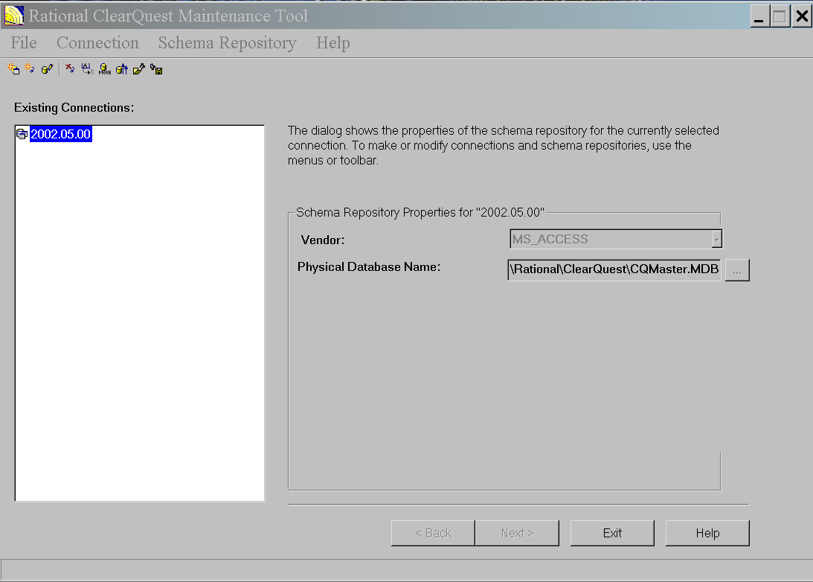
ClearQuest User Data base
Ms Access
DB2
Oracle
SQL Server

Slide 8
Rational Software Licensing Options
Start Up
License
With 30 day Expiration Date
Permanent License Options
License
Server
Node-Locked
License
Floating
Floating
Floating
Floating
Notes:
There are three different kinds of license keys:
The Start up License key
The Term License Agreement key (TLA) that allows use of the Rational product for a specified period of time.
The Permanent License key that allows you to run the product indefinitely.
There are two types of license options: node-locked and floating.
Floating licenses require a network and installation of the licensing server software that is included with the Rational product. The license server machine must run on a NT 4.0 operating system with Service Pack 3 or later, or Windows 2000, and must have the TCP/IP network protocol.
A floating license allows for any single user on any workstation in the network to use the ClearQuest product. This license also allows full ClearQuest Web access, where the user is using a web browser that has a single session on a ClearQuest web server.
You can have a mixture of both kinds of licenses at one site.
A license is consumed any time a user logs into ClearQuest client or Designer that requires access to ClearQuest databases from a distinct machine. This means that using a ClearQuest tool, such as ClearQuest Import tool, consumes a license.
When a ClearQuest installation is complete, you are prompted to set up a startup license key. The startup key has a limited expiration date. The usual expiration date for the startup license is 30 to 90 days.
The two permanent license options are:
A node-locked license which is restricted to an individual system. The node-locked license is a simple user license for someone who uses ClearQuest only on one machine. The node-locked license is not shared. It is tied to the hardware. This license can be transferred from one user to another within the same company by making a request to Rational (via the sales force who work through Order Administration). You will then receive a new license key to replace the old one.
A floating license is shared among multiple users with one user using one license at a time. Floating licenses are designed for larger organizations where many people use ClearQuest intermittently.
The number of floating licenses depends on the account you purchased. The account number you are given when you register specifies the number of available floating licenses.

Slide 9
ClearQuest Database Sets
Schema
Repository #1
User Database #1
Database Set #1
User Database #2
User Login
User Database #3
Schema
Repository #2
User Database #4
Database Set #2
User Database #5
Notes:
ClearQuest stores schemas in a schema repository. The schema repository is the master database that contains metadata about the user databases. It does not contain user data. The schema repository is accessed through the ClearQuest Designer.
A user database contains the information entered into the system by the end users through the ClearQuest clients. It stores change request data.
One schema repository and all of its associated user databases is referred to as a Database Set. More than one database set can reside on the same host machine.
In ClearQuest Version 2001A.04.00 of ClearQuest makes it easier to access multiple schema repositories in one ClearQuest installation. When there are two or more schema repositories at a site, end users are asked to choose a schema repository from a list of available schema repositories during the ClearQuest login process. They are then instructed to select one of the associated user databases.
Note:
Database sets are added to the login process with the installutil adddbset command. We will discuss this command and how to install a database set in Module 12.

Slide 10
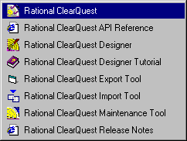
ClearQuest Components
ClearQuest Client
  Windows client, Web client, and Unix client
ClearQuest Designer
  Administration and design tool
ClearQuest Export Tool
  Export data from ClearQuest
ClearQuest Import Tool
  Import data to ClearQuest
ClearQuest Maintenance Tool
  Database setup & maintenance
Notes:
Here are the major components of ClearQuest. Most of them, can be easily identified in the Start > Programs > Rational ClearQuest menu.
ClearQuest client gives you access to ClearQuest. From this tool, you enter and modify change requests, and analyze the project progress.
ClearQuest Designer is the desktop tool used by the ClearQuest Administrator to perform administrative tasks including: defining different types of change requests the users use, designing the rules the users follow when submitting and modifying change requests, and the forms used to manipulate change request information.
ClearQuest Export Tool allows ClearQuest users to export data from ClearQuest to an external file.
ClearQuest Import Tool allows ClearQuest users to import data from external source into ClearQuest.
ClearQuest Maintenance Tool allows you to perform various maintenance tasks including creating a sample database and new schema repository, and moving and upgrading existing databases.

Slide 11
Life Cycle of the Bug
Closed by the
project manager
Closed
Verified by
QA team
Close
Postponed
fail
Verified
Postpone
ReAnalyze
fail
verify
Bug Submit
Analyze
OpenFix
Resolve
Integrate
Submitted
analyzed
Opened
Resolved
Integrated
Defect Submitted
and becomes accessible
to all ClearQuest clients
The developer Opens a defect for start fixing it
Defect is resolved
in some approved
way
Reject
ReAnalyze
Defect is assigned
by the team leader
to a specific developer.
Rejected

Slide 12
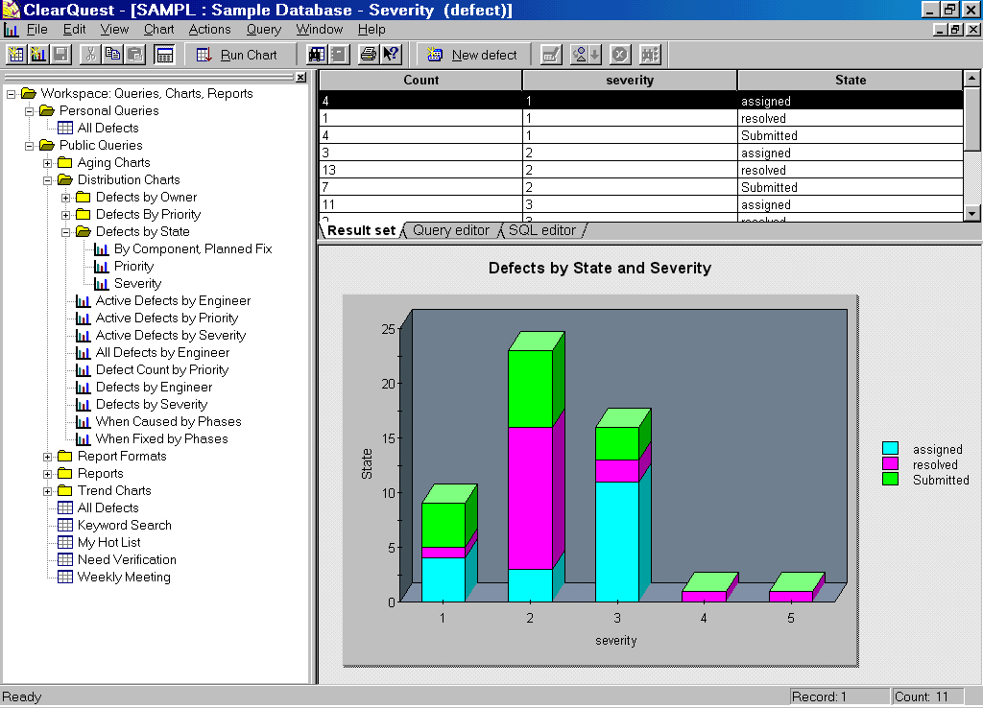
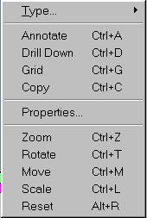
Using Clear Quest Charts
Chart data is also displayed in tabular form
Double-Click a
Pre-defined chart
Right-click the chart
To display the
Shortcut menu,
And select Drill down
To show more detail

Slide 13
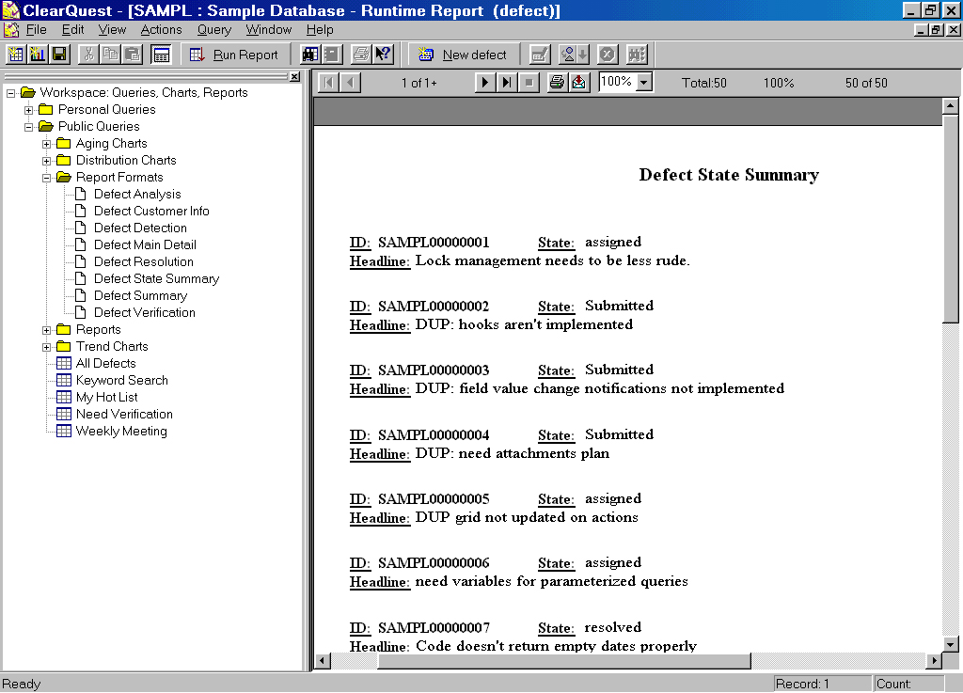
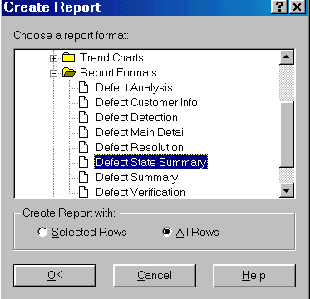
Creating reports from Clear Quest Data
Clear Quest displays the Data in the report format You selected
Select a report format

Slide 14
The Interface between ClearQuest and Crystal Reports
ClearQuest
Report Dialog
Crystal Reports
ClearQuest
Database
Fields
-------------
-------------
-------------
ADO Record set
-------------
-------------
-------------
.RPT File
-------------
-------------
-------------
Report Format
You select fields in ClearQuest to be included in your report.
You design
your report format
Layout in Crystal Reports.
You commit the finished report layout along with the associated fields in ClearQuest.
Notes:
ClearQuest and Crystal Reports perform different tasks in producing the report format. The operation of Crystal Reports does not go through the ClearQuest Core.
On the ClearQuest side, you use the Report dialog box to select a list of fields to be included in your report format. ClearQuest then tells Crystal Reports what fields will be available in the report. Once the list is created in ClearQuest, you gain access to the Crystal Reports directly from that dialog box.
In Crystal Reports, you design your report format layout. Crystal Reports then generates the corresponding Active Data Object (ADO) record set.
Back in ClearQuest, when you commit your customized report format, the ADO file is translated into a .RPT file and stored in the ClearQuest database.

Slide 15
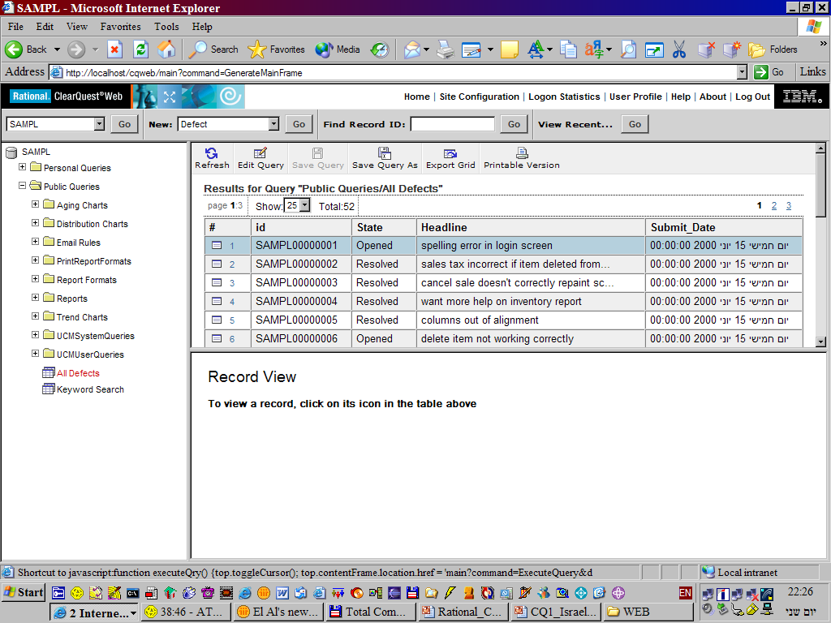
ClearQuest WEB

Slide 16
Problem
3D chaos
  In the IT Department
  In the Human Resource Department
  In the QA Department
Impossible to deal manually with mass of information

Slide 17
The Helpdesk System should provide solutions for
Human Resources
IT
QA/QC
Finance and high-level management

Slide 18
Why ClearQuest?
Suited to organization (Already integrated)
Inexpensive
Familiar with manual of operation
Easy to:
  Design
  Implement
  Maintain
Accessible Technical SUPPORT

Slide 19
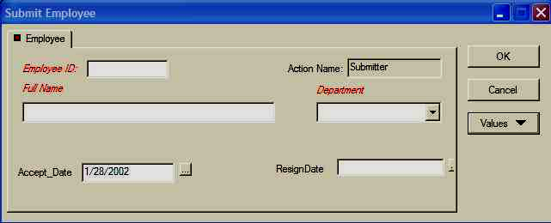
Solution for - Human Resources
Create a company record for each employee
  Give ID Number
  Possible to attach any kind of document (contract)

Slide 20
Solution for - IT
Create a company record for each type of equipment (above X $)
  Computer
  Screen
  Printer
Connect records to the relevant employees using the equipment.
Ownership brings more responsibility and concern
for equipment maintenance.

Slide 21
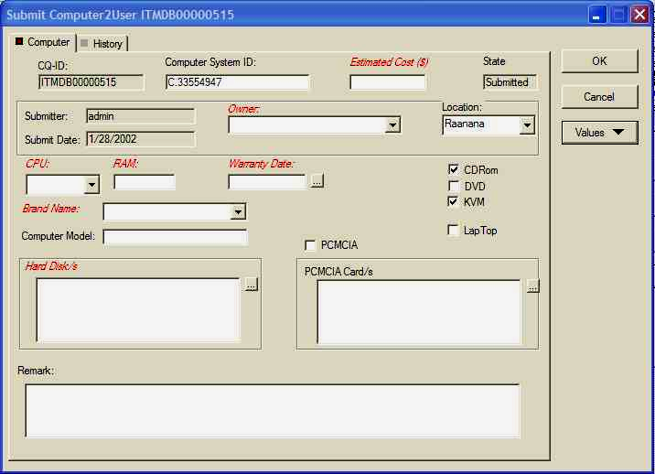
Solution for – IT (Computer record)

Slide 22
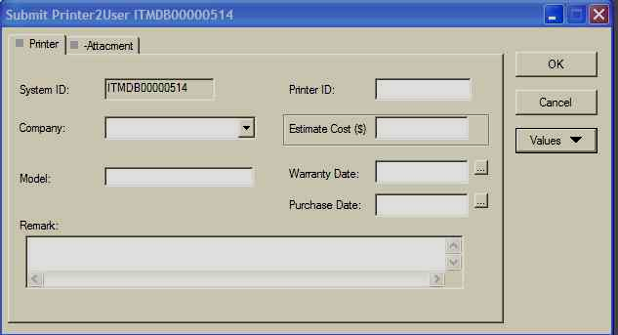
Solution for – IT (Printer record)

Slide 23
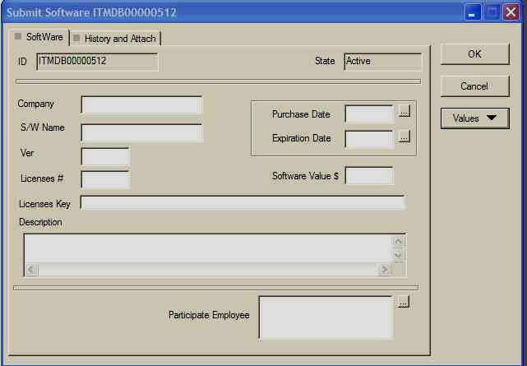
Solution for – IT (Software purchase record)

Slide 24
Solution for - QA/QC
To manage interactions between machines and configurations in intensive work with “GHOST”.

Slide 25
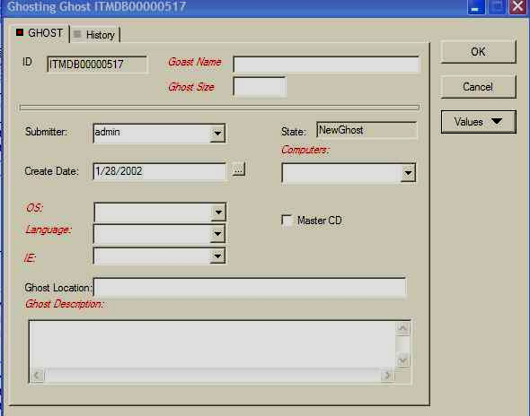
Solution for QA/QC

Slide 26
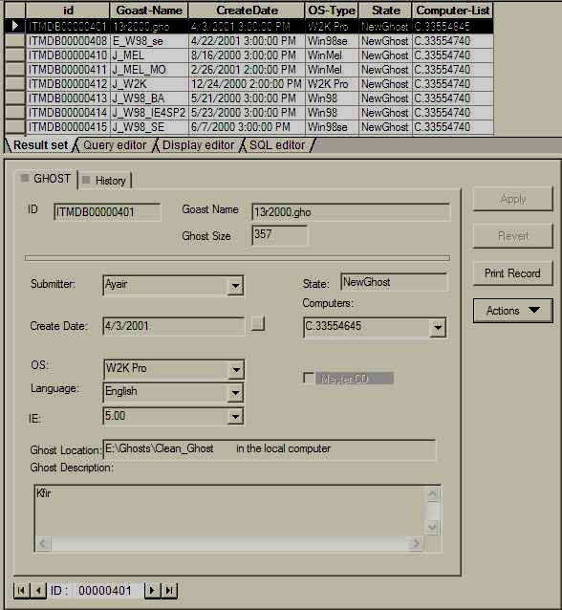
Solution for QA/QC (Form with queries)

Slide 27
Solution for – Finance/Management
Prepare reports of equipment acquisition.
Prepare expense reports for defined yearly quarters.
Controlled supervision of all equipment (hardware and software), including repair, maintenance, upgrades and acquisition.

Slide 28


